Slide 1
Lawn Buddy
“The cutting hedge technology”
Milestone #3: Business Model Design & AI-powered Operating Models
Gasser Ahmed
MGT 5824
7/21/2023

Slide 2
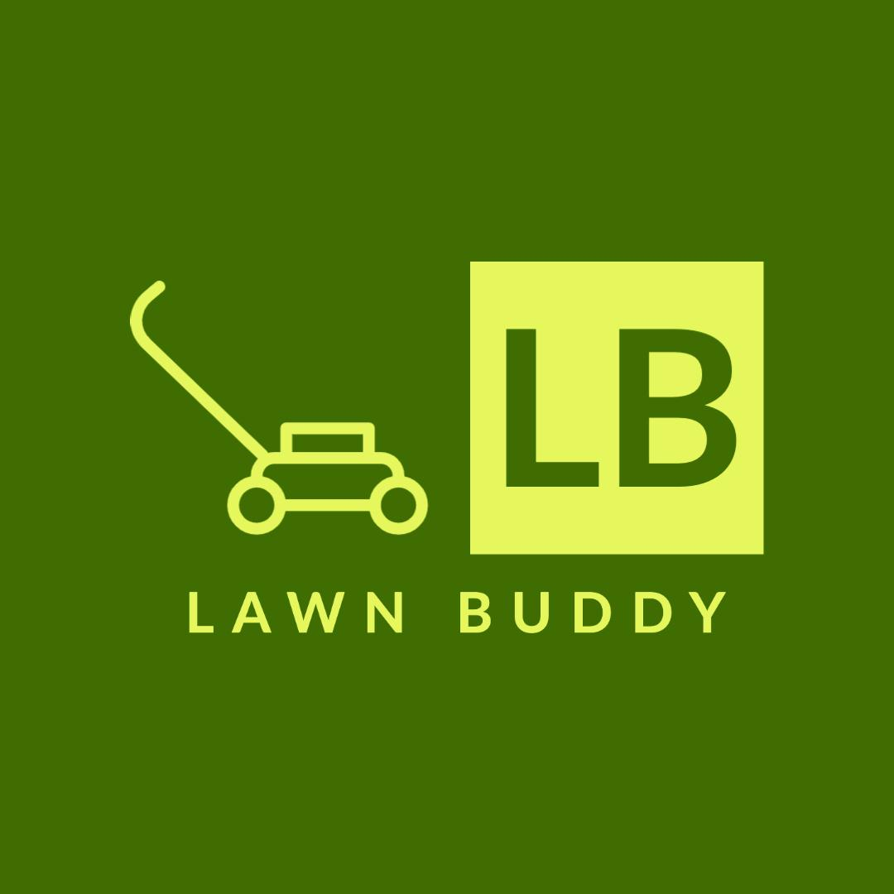









Business Model Canvas
Key Partners
Key Activities
Key Resources
Lawn care service providers (individual contractors or companies)
GPS and mapping services for location tracking
Payment gateway providers
AI and data analytics companies for AI technology integration
Marketing and advertising partners for promoting the app
App development and maintenance
Partnering with lawn care service providers
Integrating AI algorithms for scheduling and route optimization
Customer support and relationship management
Continuous improvement of the AI algorithms and app features
Marketing and promotion of the app
Skilled app developers and designers
AI experts and data scientists
Server infrastructure for data storage and processing
Partnership agreements with lawn care service providers
Marketing and promotional resources
Customer support team
Customer Relationships
Channels
Customer Segments
User-friendly app interface for easy scheduling and communication
Prompt customer support through in-app chat, email, or phone
Regular updates and improvements based on customer feedback
Personalization of lawn care plans to meet individual customer needs
Mobile app stores (e.g., Apple App Store, Google Play Store)
Website for app promotion and customer onboarding
Social media platforms for marketing and advertising
Collaborations with hardware stores or gardening centers
Middle-aged and older residential homeowners with lawns/gardens
Commercial properties with lawns/gardens (e.g., offices, hotels, schools, parks)
Value Proposition
Revenue Model
Cost Structure
Convenient and efficient lawn mowing scheduling using AI technology
Time-saving for customers by automating lawn care services
Personalized lawn care plans based on lawn size, location, and specific needs
Reliable and skilled lawn mowing service providers
Real-time updates and notifications for customers
Commission-based: Charge a percentage of each lawn mowing service payment made through the app.
Subscription model: Offer premium plans with additional features for a monthly or yearly fee.
Advertisements: Allow local lawn care businesses or related companies to advertise within the app.
App development and maintenance costs
AI integration and data analytics expenses
Marketing and advertising costs
Customer support and relationship management expenses
Server hosting and maintenance fees
Operational costs associated with running the platform

Slide 3
Financial Models: Gross Margin Model
Financial Metrics | Formulas | Monthly Values
Total Scheduled Mowing Services | N/A | 30,000 services
Average Service Cost | N/A | $80 per service
Commission Rate | N/A | 30%
Revenue | Total Number of Services x Average Service Cost x Commission Rate | 30,000 x $80 x 0.30 = $720,000
Cost of Goods Sold (COGS) | Total Number of Services x Payments per Service to Providers | 30,000 x $20 = $600,000
Gross Margin | Revenue - COGS | $720,000 - $600,000 = $120,000
(Description is included below in the Notes section)
Notes:
The table above summarizes the financial metrics, data, formulas, and monthly values for Lawn Buddy. As shown, the total scheduled mowing services are 30,000 per month, with an average service cost of $80. Lawn Buddy charges a 30% commission rate on the service cost.
Using the formulas provided, we calculate the monthly revenue, COGS, and gross margin. The monthly revenue is $720,000, and the COGS is $600,000, resulting in a positive gross margin of $120,000. This positive gross margin indicates that Lawn Buddy is profitable at the gross profit level, as the revenue generated from commissions exceeds the cost of goods sold (payments to lawn care service providers).
Strategies Implemented for positive gross margin:
1. Increased Service Volume: Lawn Buddy attracted more customers and service providers, resulting in 30,000 scheduled mowing services per month.
2. Optimized Commission Structure: The app adjusted the commission rate to 30%, allowing for higher revenue while remaining competitive.
3. Negotiated Better Deals with Service Providers: Lawn Buddy successfully negotiated more favorable rates with lawn care service providers, reducing the cost of goods sold.
4. Enhanced Efficiency through AI: AI-driven scheduling and route optimization algorithms improved the efficiency of service providers, reducing associated costs.
Continuing to implement effective strategies and monitoring financial performance will be crucial for Lawn Buddy to sustain its positive gross margin and profitability as a successful AI lawn mowing scheduling profitable mobile app startup.

Slide 4
Financial Models: Operating Model
Data | Formula | Monthly Value
App Development and Maintenance Expense | - | $10,000
AI Integration and Data Analytics Expense | - | $8,000
Marketing and Advertising Expense | - | $15,000
Customer Support Expense | - | $6,000
Server Hosting and Maintenance Expense | - | $5,000
Total Monthly Operating Expenses: | Sum of all operating expenses | $10,000 + $8,000 + $15,000 + $6,000 + $5,000 = $44,000
Gross Margin (from previous data): |  | $120,000
Net Profit: | Gross Margin - Total Monthly Operating Expenses | $120,000 - $44,000 = $76,000
(Description is included below in the Notes section)
Notes:
With a net profit of $76,000, Lawn Buddy has a positive operating model. The app's revenue generated through commissions from a large number of scheduled mowing services, combined with cost-effective operations, has resulted in a profitable operating business.
Strategies Implemented for positive net profit:
1. Streamlined Operations: The company optimized its operations, ensuring that the resources allocated to app development, AI integration, marketing, customer support, and server hosting are used efficiently.
2. Effective Marketing: Lawn Buddy implemented targeted marketing strategies that attracted a significant number of customers and service providers, resulting in increased revenue.
3. Cost Control: The company carefully managed operating expenses by negotiating favorable deals with service providers and service cost optimization.
4. Scalability: Lawn Buddy efficiently scaled its operations as the user base and service providers grew, benefiting from economies of scale.
To sustain this positive operating model and continued profitability, Lawn Buddy must continue to monitor its financial performance, implement cost-saving measures, and explore opportunities for growth and expansion. Regular financial analysis and data-driven decision-making will be essential to ensure the app's long-term success

Slide 5
Financial Models: Working Capital Model

Slide 6
Financial Models: Financing Model

Slide 7
AI Operating Model: Scalability Analysis

Slide 8
AI Operating Model: Viability and Sustainability Analysis

Slide 10
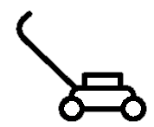





Business Model Canvas
Key Partners
Key Activities
Key Resources
A lawn service platform to connect individuals to their community.
Providing expertise lawn care services for everyone, everywhere.
A pioneering idea, a first of its kind. We actively implement ease and efficiency and in return customer satisfaction.
Customer Relationships
Channels
Customer Segments
Production will be covered in house with overall cost of $60,000.
Annual startup expenses: $855,653.00
6-month sales projection: $441,000.00
Breakeven sales level: $67,752.00
Targeting all people e.g., busy, physically unable to provide care of their lawn, do not have lawn care tools, and tech enthusiasts.

Slide 11
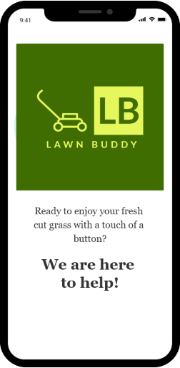
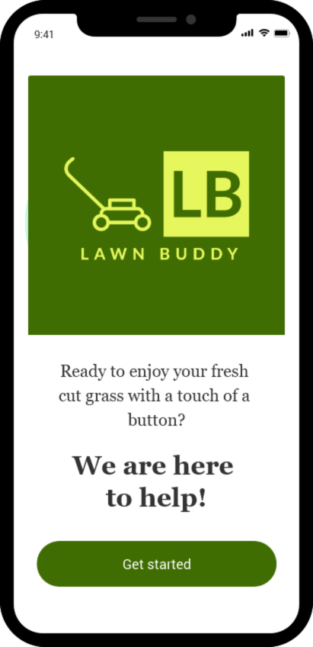
Low-Fidelity Prototype Wireframe
Landing Page
Sign In
Sign Up
Sign In
Sign Up
<
<
Email*
Full Name*
johnsmith@gmail.com
John Smith
Password*
Email*
***************
johnsmith@gmail.com
Password*
Sign In
***************
Forgot Password? Sign Up
Sign Up
Already have an account? Sign In
Sign In
Sign Up
(Description is included below in the Notes section)
Notes:
The app starts with the landing page where we welcome users and allow existing users to sign in into their accounts using email and password or new users to sign up for a new account using their full name, email, password

Slide 12

Low-Fidelity Prototype Wireframe
Dashboard
Scanning Instructions
Hi, John!
Scanning Instructions
Find a clear and well-lit area of your lawn.
Hold your mobile device parallel to the ground and align the camera view to capture your entire lawn within the frame.
Slowly move your device across the lawn, ensuring that the camera covers the entire area.
Maintain a steady and smooth movement while scanning to capture accurate data.
Once you have completed scanning your entire lawn, tap the "Done" button to process the captured data.
The app will then analyze the scanned information to determine the size, shape, and characteristics of your lawn.
Current Location: Blacksburg, VA
Current Temperature: 78°F
Today's Forecast: Sunny
Tomorrow's Forecast: Partly Cloudy
Get Started
Scan My Lawn
(Description is included below in the Notes section)
Notes:
Once logged in, users are taken to their dashboard. This central hub provides an overview of upcoming mowing sessions and weather updates. It's designed to keep users informed and in control of their lawn maintenance. To help users take their first step, we have a prominent "Get Started" button on the dashboard.
By clicking it, users will navigate to the lawn scanning instructions which provides a clear step-by-step guidance on capturing their lawn using the app to ensure accurate lawn analysis

Slide 13
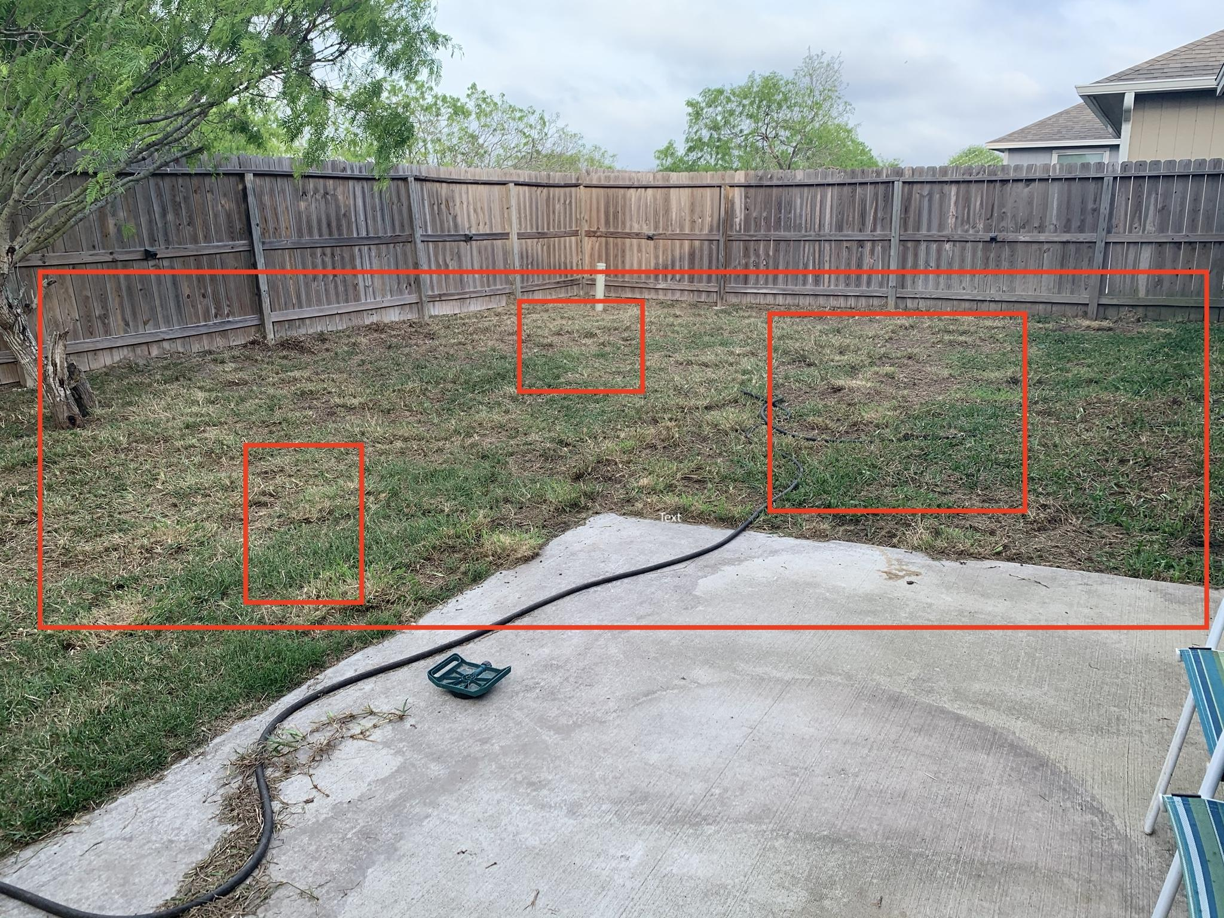
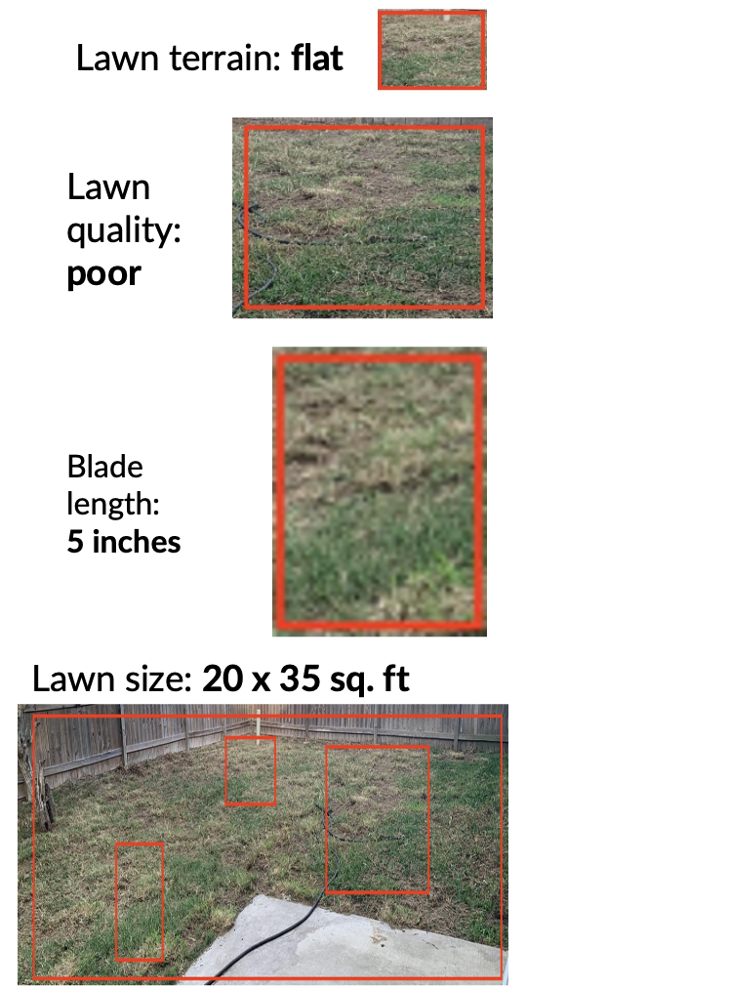
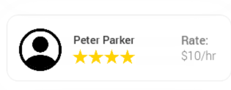
Low-Fidelity Prototype Wireframe
Scan
Scan Results
Suggestion
Lawn Info
Suggested Lawn Professional
Days
Mon
Wed
Fri
Duration
Weekly
Done
Monthly
Schedule Service
Checkout
(Description is included below in the Notes section)
Notes:
Next, we have the lawn scan page. Using the device's camera, users can scan their lawn, following the instructions provided. It's an interactive and user-friendly experience, empowering users to take control of their lawn care journey. After the scan, our advanced AI algorithms work their magic.
On the lawn info page, users are presented with comprehensive insights and analysis of their lawn. Our AI system evaluates the lawn's condition and identifies areas of concern.
Next, we leverage the power of Machine Learning to suggest trusted lawn care professionals in their area. The suggested lawn care professional page utilizes intelligent algorithms to detect available professionals based on proximity and user preferences

Slide 14

Low-Fidelity Prototype Wireframe
Checkout
Confirmation
Dashboard
Order Summary
Hi, John!
Lawn Professional: Peter Parker
Date: August 15, 2023 - 9:00 AM
Total Amount: $50.00
Billing
Name: John Doe
Address: 123 Main Street, Blacksburg, VA
Email: johnsmith@gmail.com
Phone: (123) 456-7890
Your Appointment is Confirmed
Lawn Professional: Peter Parker
Date: August 15, 2023 - 9:00 AM
Total Amount: $50.00
CC: **** **** **** 1234
Upcoming Appointment
Payment Method
Next Session: July 15, 2023 - 9:00 AM
Remaining Time: 3 days, 6 hours, 32 minutes
CC: **** **** **** 1234
Expiration Date: 07/25
CVV: ***
Confirmation #: 123456789
Current Location: Blacksburg, VA
Current Temperature: 78°F
Today's Forecast: Sunny
Tomorrow's Forecast: Partly Cloudy
Confirm Appointment
Back to Dashboard
(Description is included below in the Notes section)
Notes:
When user is ready to schedule the service, our checkout page streamlines the process. The user-friendly interface presents a summary of the order, including the selected date, time, and total cost. Users can review and confirm their choices before proceeding.
Finally, we have the confirmation page, which serves as a confirmation of the scheduled lawn mowing service. It displays the order details and provides a clear confirmation message.
Additionally, a convenient ”Back to Dashboard" button is available, allowing users to quickly access their dashboard where upcoming appointments are displayed.

Slide 15
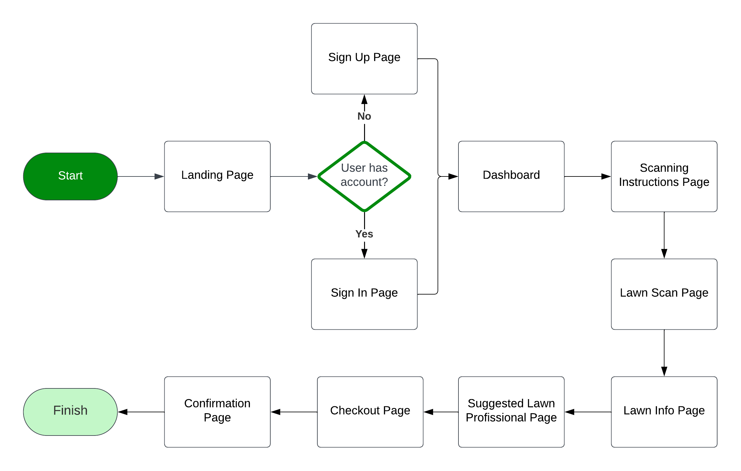
Low-Fidelity Prototype User Flow Diagram
(Description is included below in the Notes section)
Notes:
For the app flow diagram, the app begins with a landing page
Moving on to the sign-in page, users can securely access their accounts. The sign-in page provides a simple and intuitive interface for users to enter their credentials and gain access to their personalized dashboard.
For new users, the sign-up page offers a seamless onboarding process. Users can create their accounts by providing their details, including name, email, and password. This step opens up a world of personalized lawn care services.
Once signed in, users are directed to their dashboard with a prominent "Get Started" button.
To ensure accurate lawn analysis, Lawn Buddy guides users through the lawn scanning process. The lawn scanning instructions page offers step-by-step guidance on capturing their lawn using the app's camera. This enables the app to analyze the lawn and provide valuable insights.
Users proceed to the lawn scan page, where they can capture their lawn using the app's camera. The app utilizes advanced AI object recognition technology to analyze the image, identifying lawn boundaries and object edges with precision.
Leveraging the power of AI, Lawn Buddy's object recognition technology delivers accurate lawn scan results. The AI analyzes the captured image, identifying elements such as trees, flowerbeds, and fences. This information contributes to precise lawn measurements and enables effective lawn care recommendations.
Lawn Buddy goes beyond scheduling by providing suggestions for trusted lawn care professionals. By utilizing AI, the app matches users with the most suitable professionals based on their preferences and lawn care needs. This feature ensures users have access to reliable and skilled professionals for their lawn care requirements.
Then the checkout page allows users to securely make payment directly through the app. This seamless checkout experience saves time and eliminates any unnecessary hassle.
After completing the checkout process, users are presented with a confirmation page. This page provides assurance that their appointment has been successfully booked. Additionally, it offers a convenient button to return to the dashboard, where users can view their upcoming appointments and track their lawn care schedule.

Slide 16
Low-Fidelity Prototype Description: Object Recognition
Lawn Buddy has a thorough dataset of all types of lawns in order to have the most accurate reading of the image recognition. By analyzing the pixels in the image recognition, Lawn Buddy can interpret and understand the logistical nature of lawn care services needed.
By analyzing the dataset, Lawn Buddy uses the criteria of computer vision in order to break down the classification, localization and tagging. Lawn buddy uses the classification feature to detect the lawn, and the use of localization to determine lawn size, and the tagging feature to further find the lawn quality, which is measured through lawn color, and blade length which determines when the lawn needs to be trimmed.
Lawn quality: measured by the appearance and color of the lawn. Ex. yellow lawn = poor quality
Blade length: measured by analyzing the individual blade. Ex. blade > 3 inches = long, time for maintenance
Lawn size: measured by the phone's AR feature. Ex. 20 x 15 sq. ft.
Lawn terrain: measured by the topography of the yard. Ex. hills = non-flat terrain
Lawn Buddy uses location services to determine weather patterns like rain and drought to determine the rate of grass growth and then lawn maintenance scheduling.

Slide 17
Low-Fidelity Prototype Description: Use Case
A differently abled person wishes to take care of his lawn but physically can not do so. He wants to find the best price in his area, so he downloads Lawn Buddy. He uses the object recognition technology that is featured in the app in order to scan his lawn. From his window, he is able to get a good image of his front yard and the Lawn Buddy app detects his lawn size, lawn terrain, lawn quality, and lawn blade length. By determining the four criteria, Lawn Buddy will automatically create a schedule for lawn maintenance, as well as suggesting a lawn professional and his price ranges. The individual will confirm the scheduling details, and lawn criteria, and his lawn will be under the care of Lawn Buddy for the length of time he desires. Lawn Buddy is able to provide lawn maintenance up to once year in advance.
On the scheduled day, the lawn professional comes to your domicile, and provides the lawn care services needed and leaves. His payment and tip is fulfilled through the app, so no contact needed.
By using the image recognition technology from Lawn Buddy, the checkout experience is more efficient and user-friendly, especially for sick, elderly or differently abled persons that like to enjoy a maintained lawn.

Slide 18
Social and Technological Affordances User Interaction
The AI lawn mowing scheduling app offers a user-friendly interface with intuitive interactions, ensuring a seamless user experience.
Users can easily schedule mowing sessions, manage their lawn care preferences, and view upcoming appointments.
The app provides clear instructions and guidance throughout the scheduling process, reducing user effort and minimizing cognitive load.
Accessibility features, such as adjustable font sizes, color contrast options, and voice-guided navigation, enhance inclusivity for users with diverse needs.
Push notifications and reminders keep users informed about upcoming appointments, improving engagement and reducing the likelihood of missed sessions.

Slide 19
Social and Technological Affordances Social Implications
The app contributes to environmental sustainability by optimizing lawn care practices, reducing emissions, and promoting water and chemical conservation.
It may have social implications regarding job displacement for traditional lawn care workers, necessitating considerations for retraining or alternative employment opportunities.
Ethical considerations include ensuring data privacy and security, transparent use of customer information, and responsible AI decision-making processes.
Users benefit from the convenience and time-saving aspects of the app, allowing them to focus on other activities or spend quality time with family and friends.
The app's automation of lawn care tasks reduces human labor, potentially freeing up resources for other important societal needs.

Slide 20
Social and Technological Affordances Technological Affordances
Lawn Buddy leverages current technology, particularly object recognition, to accurately identify lawn boundaries and obstacles.
Object recognition algorithms analyze images captured by the app's camera, identifying objects such as trees, flowerbeds, and fences.
The app evaluates the accuracy and reliability of object recognition, considering factors like lighting conditions and potential limitations in detecting complex or irregular lawn shapes.
Pushing technological boundaries may involve exploring advanced object recognition techniques, such as machine learning and deep neural networks, to improve the precision and efficiency of lawn boundary detection.
The app's use of object recognition technology enhances the accuracy of lawn measurements, ensuring optimal scheduling and mowing coverage.

Slide 21
AI Technology Stack Schematics Hardware and Infrastructure: Hardware Components
User Devices:
Smartphones or tablets: These devices act as the primary interface for users to interact with the app and schedule mowing sessions.
Cameras: User devices with built-in cameras capture images of the lawn for object recognition and measurement.
Object Recognition and Measurement:
Image Processing Unit (IPU): Integrated into user devices, IPUs assist in accelerating image processing tasks.
Deep Learning Models: Pretrained convolutional neural network (CNN) models capable of detecting and segmenting objects within the lawn images.

Slide 22
AI Technology Stack Schematics Hardware and Infrastructure: Cloud Services
Amazon EC2 Cloud Computing: Compute Cloud provides resizable compute capacity for hosting backend services, handling user requests, data flow, business logic, AI model training, and inference.
Amazon S3 Cloud Storage: Provides scalable and secure cloud storage for storing user data, including lawn images, preferences, and schedules.
Amazon SageMaker AI Model Training: A fully managed machine learning service that provides infrastructure for training and deploying models at scale.
Amazon Redshift Data Analytics: A fully managed data warehousing service for analyzing large datasets and deriving insights.

Slide 23
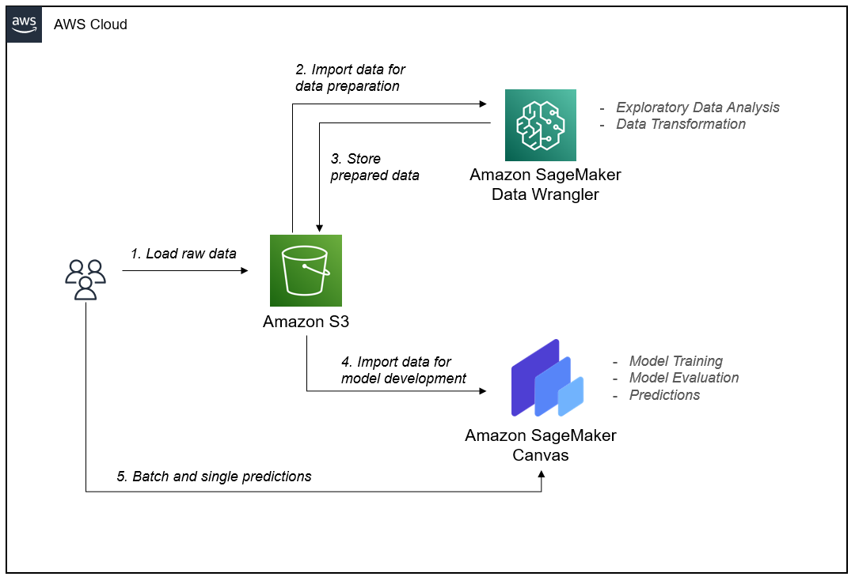
AI Technology Stack Schematics Hardware and Infrastructure: Amazon SageMaker Workflow
https://aws.amazon.com/blogs/machine-learning/build-a-risk-management-machine-learning-workflow-on-amazon-sagemaker-with-no-code/

Slide 24
AI Technology Stack Schematics Software
Programming Language and Development Tools:
JavaScript: The primary language for React Native app development.
Node.js: A JavaScript runtime environment that provides the necessary tools for server-side development and package management.
npm (Node Package Manager): A package manager for installing and managing JavaScript libraries and dependencies.
React Native and Related Libraries:
React Native: A JavaScript framework for building cross-platform mobile applications.
Expo: A set of tools and services for developing and deploying React Native apps with ease.
Axios: A promise-based HTTP client for making API requests from the app.
Formik: A library for building forms and managing form state.

Slide 25
AI Technology Stack Schematics Software
AI and Machine Learning Frameworks:
TensorFlow.js: A JavaScript library for training and deploying machine learning models directly in the browser or on the device.
MobileNet: A pre-trained deep learning model for image classification that can be used for object recognition in the lawn images.
OpenCV.js: A JavaScript port of OpenCV, providing computer vision functionalities for image processing and analysis.
Weather Data APIs: Integration with weather data APIs (e.g., OpenWeatherMap, Weather API) for incorporating weather conditions into mowing schedules.
Visual Studio Code IDE: A popular lightweight IDE for web and mobile app development with support for React Native.

Slide 26
AI Technology Stack Schematics Data
User Data:
User Profiles: Data such as names, contact information, and preferences (e.g., mowing frequency, preferred dates) are collected during the user registration process.
Lawn Measurements: Users provide lawn dimensions either manually or using object recognition algorithms to measure the lawn area accurately.
Scheduling Data: Information about scheduled mowing sessions, including dates, times, and frequency, is collected to manage and organize the mowing service.
Data Collection:
User Input: Users enter their profile information, lawn measurements, and scheduling preferences directly into the app.
Object Recognition: If object recognition algorithms are used for lawn measurement, images of the lawn are captured either through the app’s camera.

Slide 27
AI Technology Stack Schematics Data
Data Processing:
Image Processing: If object recognition is involved, the images captured by the app's camera or uploaded by the user are processed to detect and identify objects like trees, flowerbeds, or fences.
Data Validation: User input for scheduling preferences is validated to ensure consistency and adherence to specified constraints.
Weather Data Integration: If incorporating weather conditions, weather data from external APIs is retrieved and processed to determine optimal mowing schedules.
Data Storage:
User data (including profile information and scheduling preferences), lawn images, and information about scheduled mowing sessions and completed sessions (for efficient retrieval and management) will be stored in Amazon S3 cloud storage.
Analytics Data: App usage and performance data, such as user interactions and errors, will be collected and stored for analysis and improvement.
(Additional Data Security and Privacy info are included below in the Notes section)
Notes:
Data Security and Privacy:
Secure Data Transmission: Secure communication protocols (e.g., HTTPS) to encrypt data transmission between the mobile app and backend servers, protecting user data from unauthorized interception.
Strong User Authentication and Access Control: Robust user authentication mechanisms (e.g., passwords, biometrics) to ensure only authorized users can access the app. Apply access controls to restrict data access based on user roles and privileges.
Encryption and Data Storage: Encryption techniques to protect sensitive user data, both in transit and at rest. Use secure storage mechanisms, such as encrypted databases or cloud storage services, to safeguard user information.
Privacy Policy and User Consent: Create a comprehensive privacy policy that outlines the types of data collected, the purposes of data usage, and how user privacy is protected. Obtain informed consent from users for data collection, storage, and usage, and provide options for users to manage their data preferences.
Compliance with Data Protection Regulations: Adhere to relevant data protection regulations, such as GDPR or CCPA, by ensuring user rights are respected, providing transparency in data practices, and facilitating user data access, modification, and deletion requests.

Slide 28
AI Technology Stack Schematics Algorithms
Object Recognition:
MobileNet: MobileNet is a lightweight convolutional neural network (CNN) architecture specifically designed for mobile and embedded vision applications. It is efficient and suitable for real-time object recognition tasks.
TensorFlow: TensorFlow is an open-source machine learning framework that can be used to train and deploy deep learning models, including MobileNet.
Training Process:
Dataset Preparation: Collect a labeled dataset of lawn images containing various objects like trees, flowerbeds, fences, and obstacles, along with their corresponding labels.
Model Training: Utilize Amazon SageMaker's training capabilities with TensorFlow to train the MobileNet model on the lawn-specific dataset. This involves feeding the labeled images into the model, adjusting the model's internal parameters (weights and biases) through an optimization process, and iterating to improve its accuracy.

Slide 29
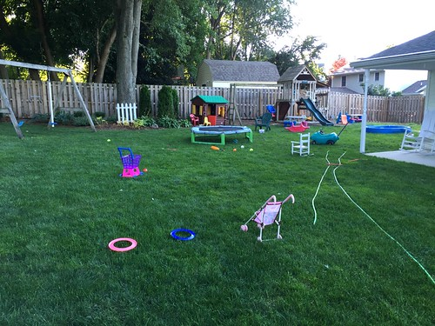
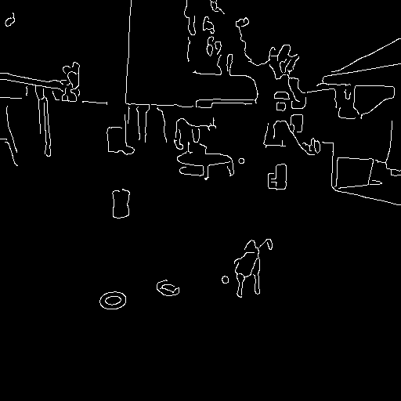
AI Technology Stack Schematics Algorithms
Image Processing:
Utilize OpenCV.js (a JavaScript library that provides computer vision algorithms for image processing and analysis tasks) to perform Canny edge detection algorithm. This algorithm helps identifying lawn boundaries and object edges within the lawn images, enabling accurate lawn measurement and obstacle detection.
Original Image
Edge Image

Slide 30
AI Technology Stack Schematics Algorithms
Machine Learning:
Regression Models: predict optimal mowing schedules based on factors like lawn size, weather conditions, and growth patterns.
Training Process:
Dataset Collection: Gather historical data on mowing schedules, lawn sizes, weather conditions, and other relevant factors.
Data Preparation: Preprocess the dataset by performing feature engineering, handling missing values, and scaling numerical features.
Model Training: Utilize machine learning algorithms like linear regression, decision trees, or random forests to train the model on the prepared dataset. The training process involves feeding the data into the model, optimizing the model's parameters, and iteratively improving its performance.

